Slide 1
Final Year Project
Independent Work App
Any One Can Earn Money

Slide 2
Team Members
3061 Pragnesh Kolipatel
3064 Krushali Kumbhani
3152 Krupesh Rathod

Slide 3
Introduction
Nowadays there are so many Event Organizer Company who need volunteers/workers for Government or Non Government Events.
We provide one plateform to people who wants to earn handsome money by doing small work.
It is best platform for students who wants part-time temporary work with good payment.

Slide 4
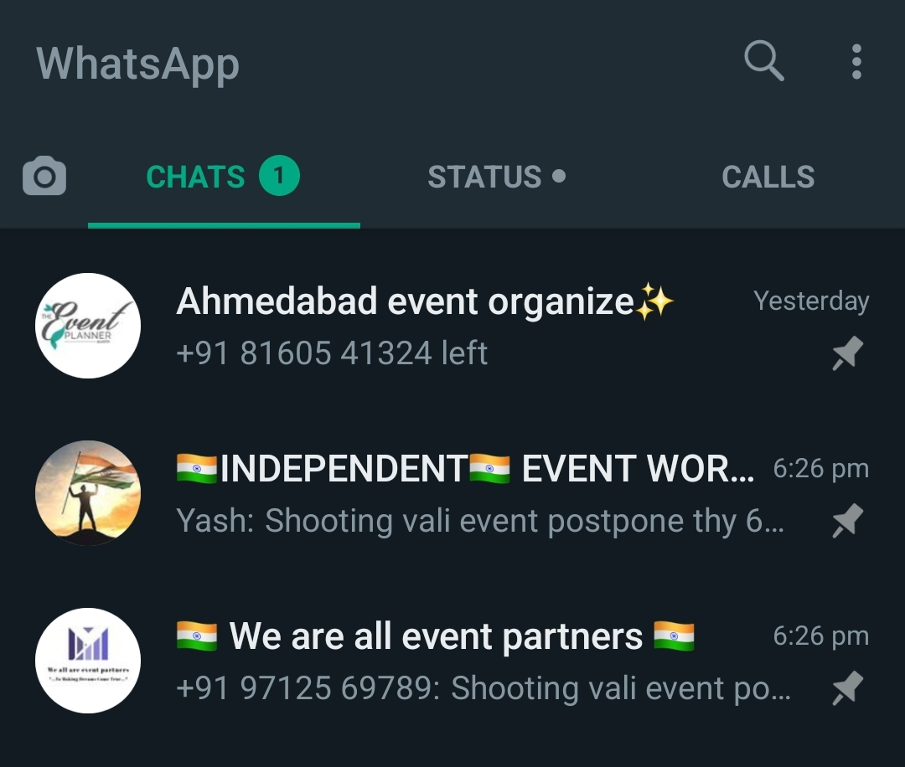
Existing System :

Slide 5
Drawbacks :
Hard to Find Whatsapp Groups
Different Payments of every Event group for same Event
Any Group Member Can misuse your mobile number
Cut more commission from full payment

Slide 6
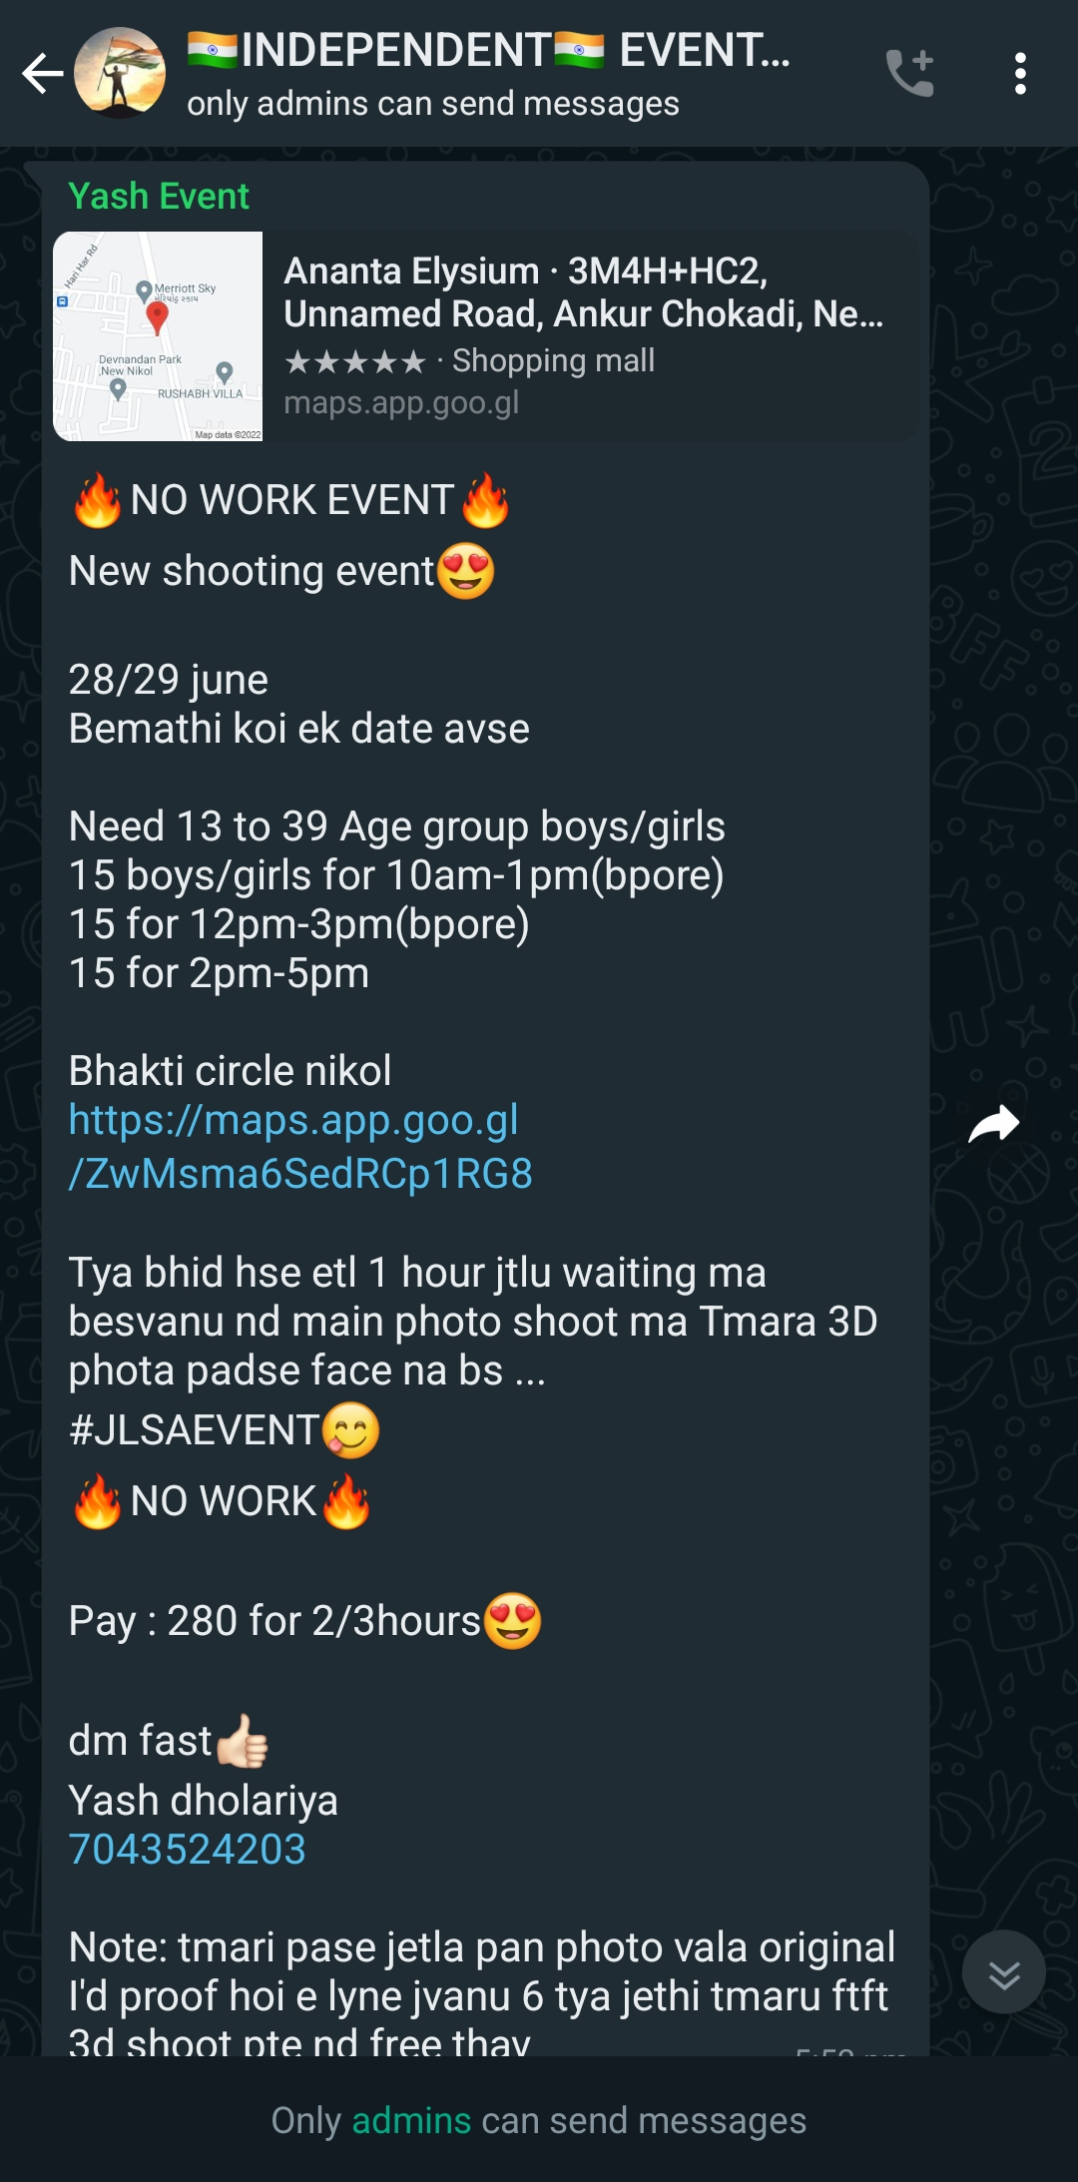
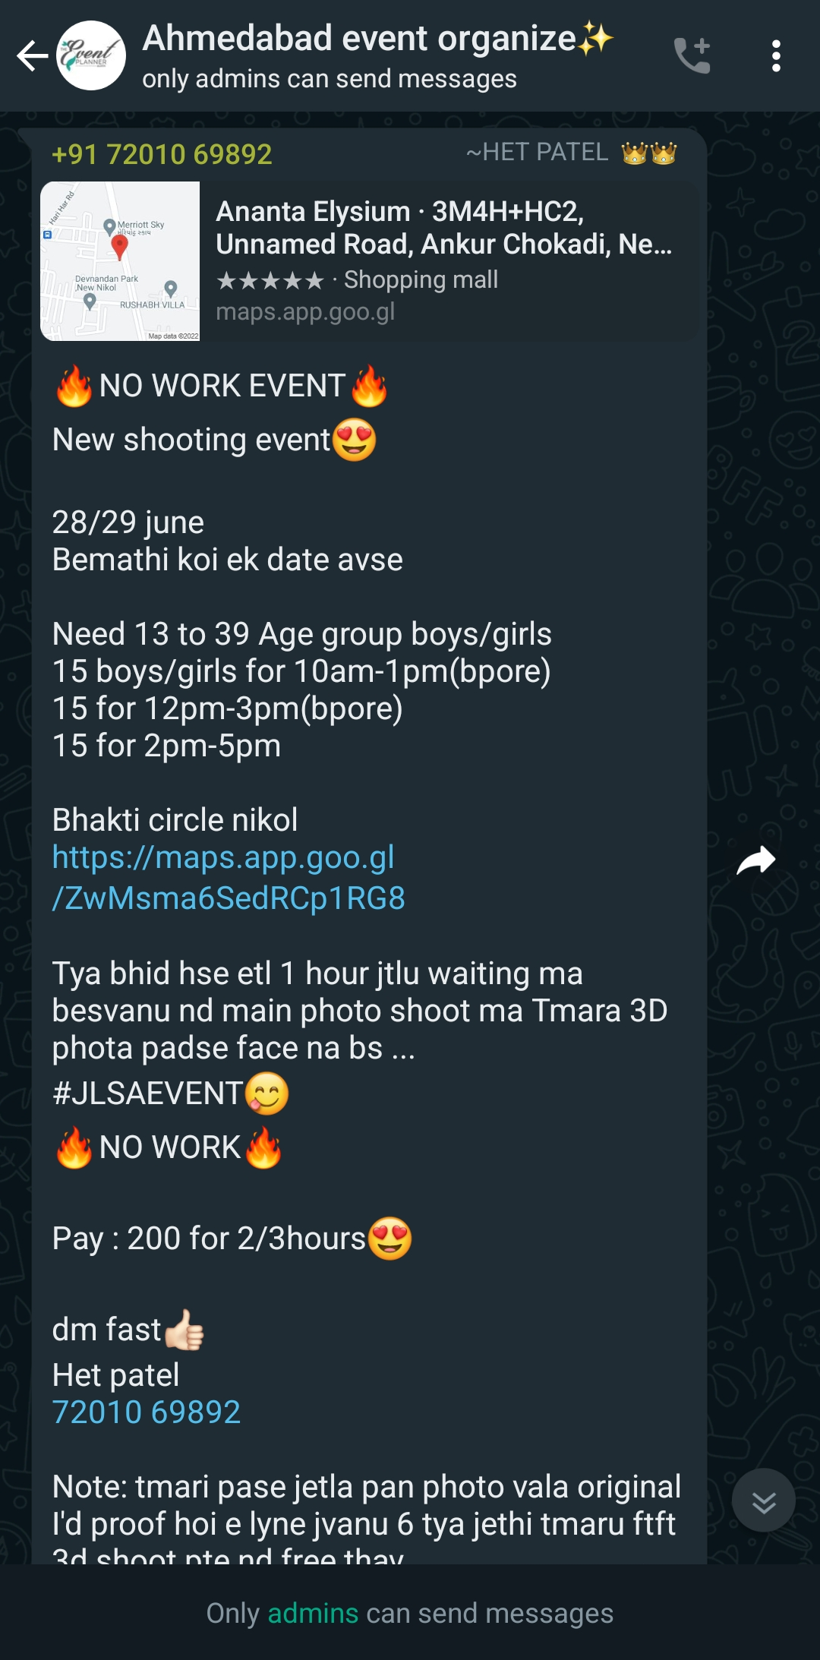
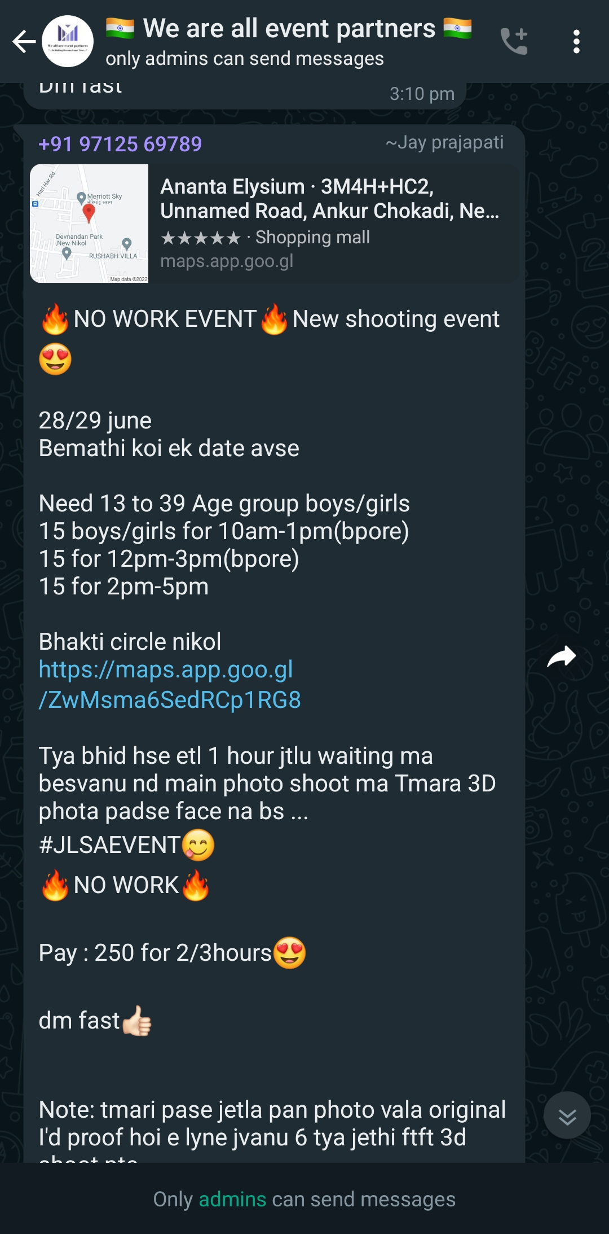
Drawbacks :

Slide 7

Add Your Title
Drawbacks :
Payment
-
Personal
commision
Payment
+
commision
Company
Whastapp Group
Workers

Slide 8
Drawbacks :
Payment
-
Personal
commision
Payment
-
Personal
commision
Payment
+
commision
Company
Whastapp Group
Whastapp Group
Workers

Slide 9
Advantages :
Easy to find Work/Workers
Fix payment
Less Cut of commisson
Direct Interaction with
Organizer
Your data Shared only with
Event organized companies

Slide 10
Tools And Technologies :
Front End :
XML
JAVA
Backend :
PHP
Database :
Sql
SQLite
Tools :
Android Studio

Slide 11

Thank You

